Slide 1



s
e
c
o
n
d
C
O
R
N
A
N
I
T
H
I
S
11.5-21
A free CD of this message will be available following the service
It will also be available for podcast later this week at calvaryokc.com

Slide 2
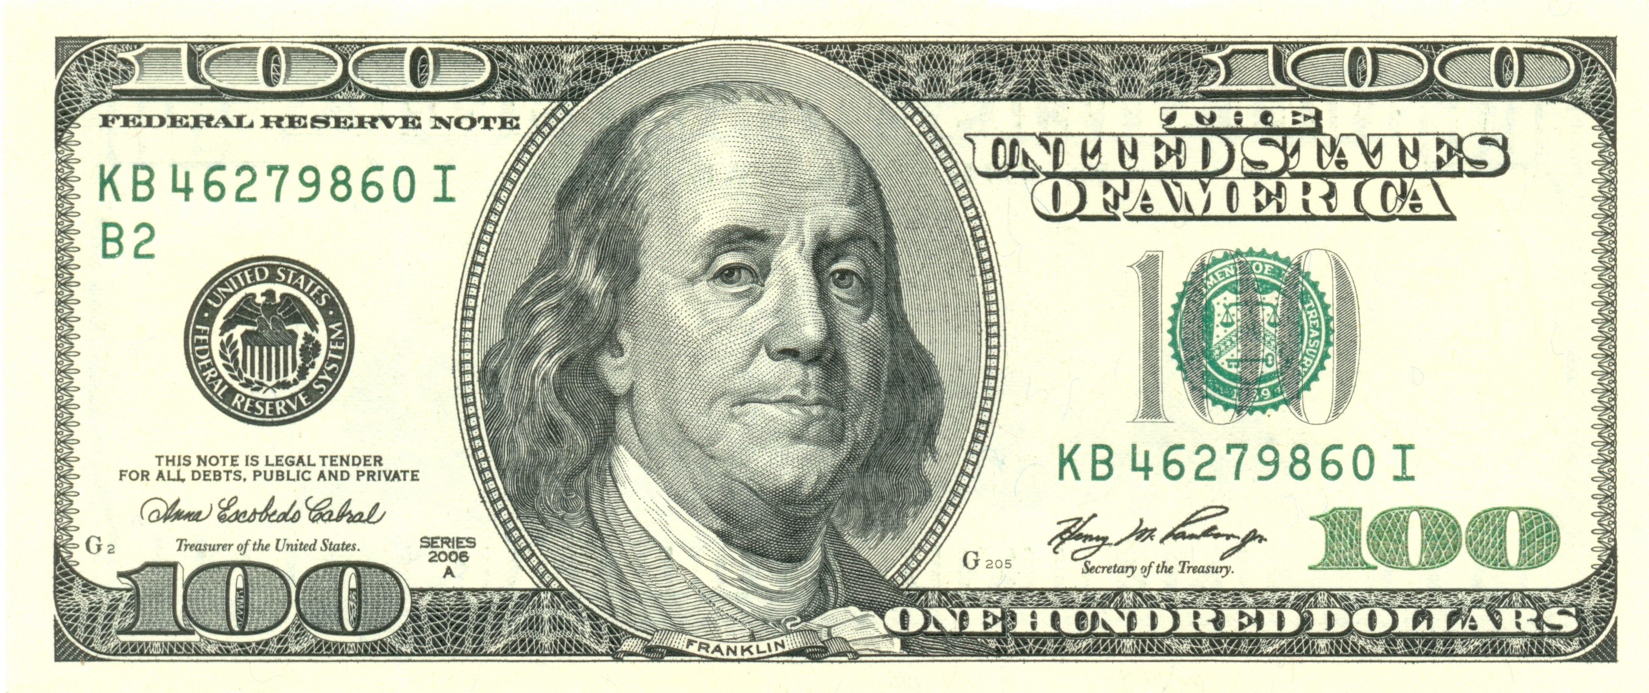
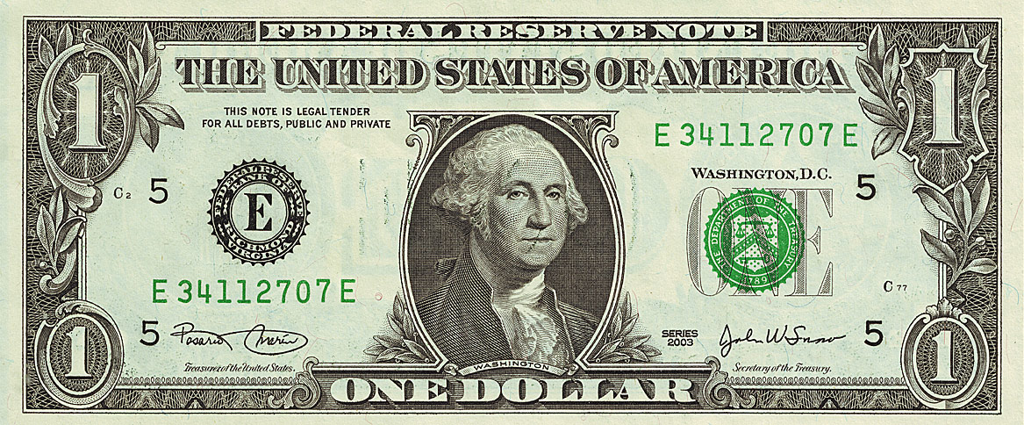
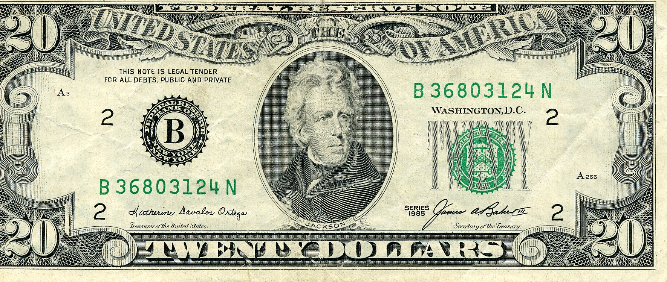
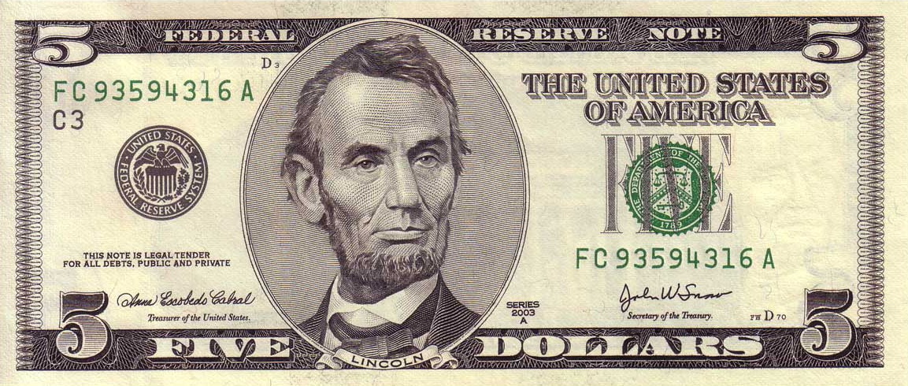

O
A
N
S
11.5-21
I
I
s
e
c
o
n
d
C
R
N
T
H

Slide 3
O
A
N
S
11.5-21
I
I
s
e
c
o
n
d
C
R
N
T
H

Slide 4
Most - huper – over
eminent - lian – exceeding
literally, the much mo’ betterest apostles
O
A
N
S
11.5-21
I
I
s
e
c
o
n
d
C
R
N
T
H

Slide 5
O
A
N
S
11.5-21
I
I
s
e
c
o
n
d
C
R
N
T
H

Slide 6
Untrained - idiōtēs – usually used when contrasting a lesser with a greater
Phillips - Perhaps I am not a polished speaker, but I do know what I am talking about, and both what I am and what I say is pretty familiar to you.
O
A
N
S
11.5-21
I
I
s
e
c
o
n
d
C
R
N
T
H

Slide 7
O
A
N
S
11.5-21
I
I
s
e
c
o
n
d
C
R
N
T
H

Slide 8
Matt. 7.15 - Beware of false prophets, who come to you in sheep's clothing, but inwardly they are ravenous wolves.
Ravenous - harpax – 5x in New Testament
Extortioners - Luke 18.11, 1 Cor. 5.10, 5.11 and 6.10
O
A
N
S
11.5-21
I
I
s
e
c
o
n
d
C
R
N
T
H

Slide 9
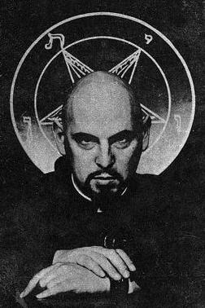

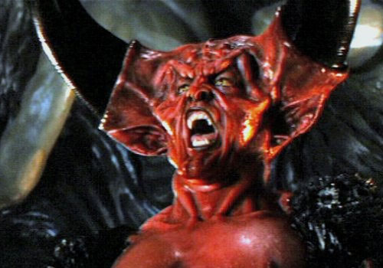


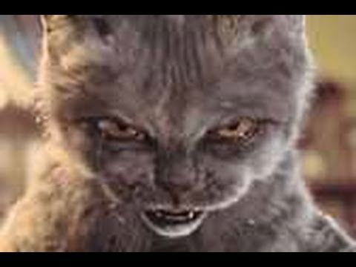


Angel of Light
O
A
N
S
11.5-21
I
I
s
e
c
o
n
d
C
R
N
T
H

Slide 10
O
A
N
S
11.5-21
I
I
s
e
c
o
n
d
C
R
N
T
H

Slide 11
1. He first inserts seeds of doubt
Gen. 3:1^{b} - Has God indeed said, “You shall not eat of every tree of the garden”?
2. Then he denies it
Gen. 3:4^{b} - You will not surely die.
3. Then he substitutes his lie
Gen. 3:5ª - “For God knows that in the day you eat of it your eyes will be opened, and you will be like God,”
O
A
N
S
11.5-21
I
I
s
e
c
o
n
d
C
R
N
T
H

Slide 12
1. He first inserts seeds of doubt
Doesn’t God’s way restrict you and keep you from having fun and being fulfilled?
2. Then he denies it
God doesn't want you to have fun and be fulfilled
3. Then he substitutes his lie
My way will provide you with fun and fulfillment
O
A
N
S
11.5-21
I
I
s
e
c
o
n
d
C
R
N
T
H

Slide 13
O
A
N
S
11.5-21
I
I
s
e
c
o
n
d
C
R
N
T
H

Slide 14
Blaise Pascal (1623-1662) - “Men never do evil so completely and cheerfully as when they do it from religious conviction.”
O
A
N
S
11.5-21
I
I
s
e
c
o
n
d
C
R
N
T
H

Slide 15
O
A
N
S
11.5-21
I
I
s
e
c
o
n
d
C
R
N
T
H

Slide 16
Merrihew Standard Version - I realize that Jesus would never talk this way, but in order to make the point, let me go over the top by tooting my own horn.
O
A
N
S
11.5-21
I
I
s
e
c
o
n
d
C
R
N
T
H

Slide 17
O
A
N
S
11.5-21
I
I
s
e
c
o
n
d
C
R
N
T
H

